Slide 1
Navy Child & Youth Programs—NSA Naples
Our programs and services are designed to meet the unique needs of the military mission, service members, and their families. With our quality programs, you can rest easy knowing your children are safe and in good care.

Slide 2
What do Navy Child & Youth Programs offer?
Child Development Centers (CDC)
School Age Care (SAC)
Teen Programs
Youth Sports and Fitness (YSF)
Child and Youth Educational Services (CYES/SLO)
Child Development Homes (CDH)

Slide 3
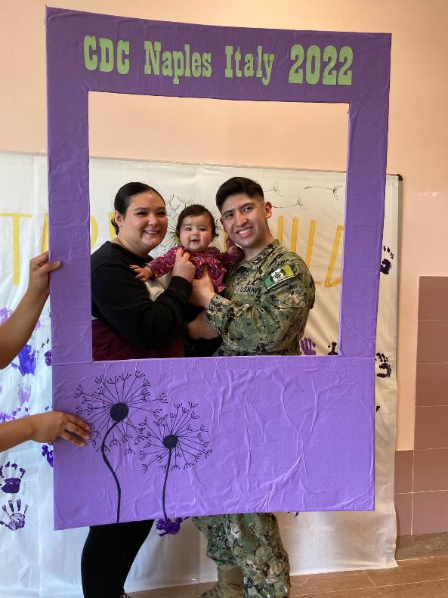
What do Navy Child & Youth Programs offer?

Slide 4
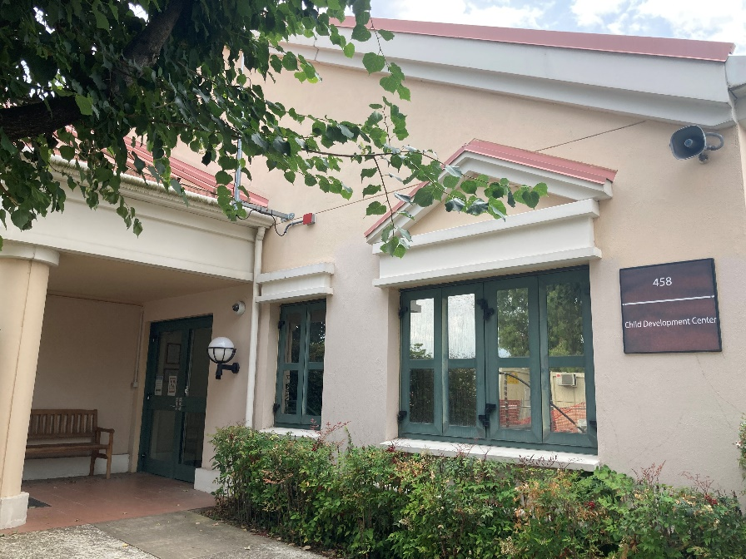
Child Development Center--Capodichino
Serving ages 6 weeks to 5 years
Hours of Operation 0600-1830 M-F
Hourly Care $7 per hour as space is available (limited to 25 hours per week per child)
National Association for the Education of Young Children (NAEYC) Accredited Program

Slide 5
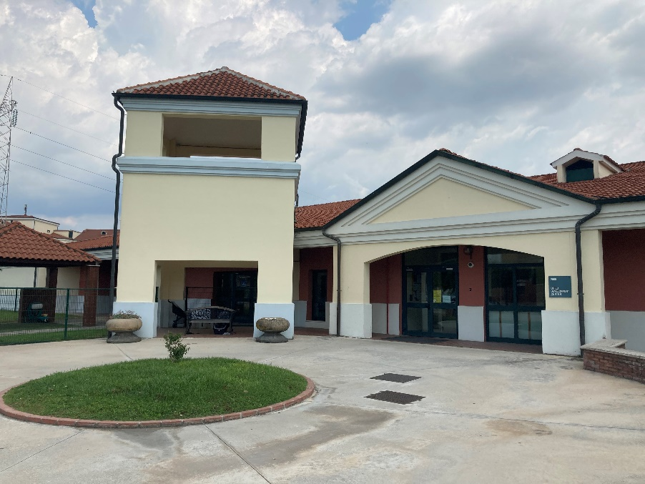
Child Development Center—Support Site
Serving ages 6 weeks to 5 years
Hours of Operation 0600-1830 M-F
Hourly Care $7 per hour as space is available (limited to 25 hours per week per child)
Wrap-Around Care for Sure Start
National Association for the Education of Young Children (NAEYC) Accredited Program

Slide 6
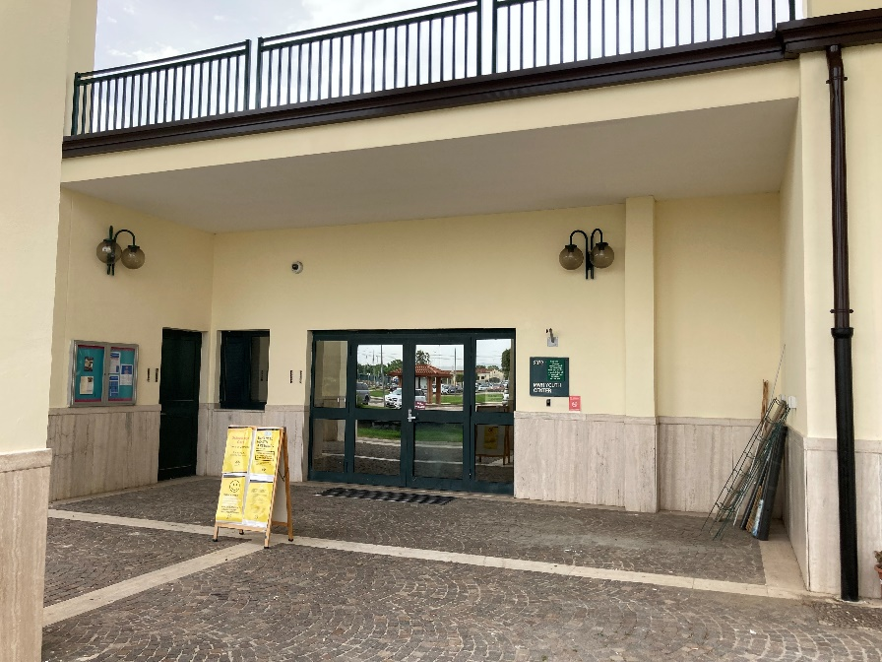
School Age Care
Serving ages 5-12 years
Provide a safe space for youth in before and after school care
Highly structured recreational and educational programs
Winter, Spring, Summer and Fall Camps
Council of Accreditation (COA) Certified Program
Partnership with Boys & Girls Club (BGCA), 4-H and Anchored4Life
Recognition Program: Youth Sponsorship, Youth of the Month and Hail & Farewell
Monthly Family and Community Events
Hourly care limits are as follows (Per child per week):
SAC Before & After School--10 hours
SAC Summer Camp--25 hours

Slide 7
Teen Programs
A positive place for teens! Teens can chill with their friends, learn something new, or get some homework done.
Field Trips
Scholarship Opportunities
Volunteer Programs
Teen Summer Hire Program
Youth Sponsorship
Clubs designed “for teens, by teens”
Leadership & Service
Education & STEM
Health & Wellness
The Arts
Sports & Recreation
Who: Teens (13-18)
When: After school and Full-days.
Where: Bldg 2072, Next to Fire Station
How: Stop by and register today.
DSN: 629-4395
Website:
www.navymwrnaples.com/

Slide 8
Youth Sports and
Fitness
Volunteer coaches are always welcome!
Serving ages 3-18 years through recreational exercise and athletics
Winter Leagues for Basketball and Cheerleading
Spring Leagues for Baseball, Softball and T-Ball
Summer Sports Clinics
Fall Leagues for Soccer and Flag Football
Fall and Spring Start Smart Sports
Fun Runs for Families

Slide 9
Child and Youth Education Services
FAMILIES - CONTACT YOUR SCHOOL LIAISON OFFICER FOR HELP WITH:
Inbound/outbound school transfer
Local schools and boundaries
Finding the right school
Understanding special education
Meeting graduation requirements
Finding military and local support services
Homeschool support
Preparing for college and scholarship information

Slide 10
Child Development Homes
CDH Providers offer a variety of care and services depending on the needs of the installation.
CDH Providers must demonstrate annually that they meet all of the Navy certification requirements before they are approved to operate a CDH.
Full- or part-time care for children ages 6 weeks to 12 years
Emergency care (emergency deployment, natural disasters, etc.)
Respite care
Hourly care
Extended hours, including nights and weekends

Slide 11
For more information, email:
MWRNaples_CYP@eu.navy.mil
NaplesSLO@eu.navy.mil
For care requests, visit:
www.militarychildcare.com

Slide 12
For more information call:
Capo CDC DSN 626-5116 / COMM 081-568-5116
SS CDC DSN 629-4989 / COMM 081-811-4989
School Age Care DSN 629-4722 / COMM 081-811-4722
Teen Center DSN 629-4395 / COMM 081-811-4395
Youth Sports and Fitness DSN 629-4725 / COMM 081-811-4725
School Liaison Officer DSN 629-6549 / COMM 081-811-6549

Slide 13
Job opportunities:
www.usajobs.com
www.navymwrnaples.com/child-youth/cyp-careers

Slide 14
Job opportunities:
Whether you're looking for a full-time career or a fulfilling side hustle, Navy Child and Youth Programs has rewarding job opportunities to fit your personal schedule and long-term goals.
Medical, dental, and life insurance
Exciting work locations
Career advancement and tuition assistance
401k with 3% employer matching
Location flexibility when you or your family need to move
FREE perks: fitness centers, pool access, preferred daycare for children

